Slide 1


Slide 2

School of Computing Science and Engineering
Course Code: BCS01T1001 Course Name: Data Analytics (Excel and Tableau)
Unit 3
Exploring Analysis Tool pack
Faculty Name: Dr.L.Godlin Atlas Program Name: B.Tech

Slide 3
Objective
Histogram
Descriptive Statistics
Moving Average
Exponential Smoothing
Correlation
Regression

Slide 4
Introduction
Exponential Smoothing
Exponential smoothing of time series data assigns exponentially decreasing weights for newest to oldest observations.
In other words, the older the data, the less priority (“weight”) the data is given; newer data is seen as more relevant and is assigned more weight.

Slide 5
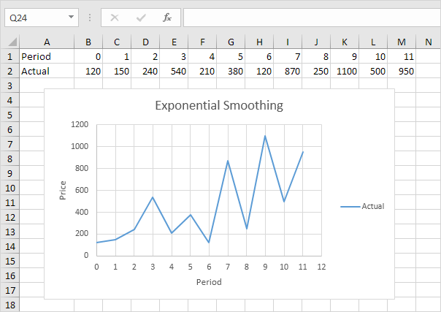
Exponential Smoothing
This example teaches you how to apply exponential smoothing to a time series in Excel. Exponential smoothing is used to smooth out irregularities (peaks and valleys) to easily recognize trends.
1. First, let's take a look at our time series.

Slide 6
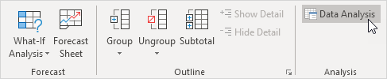
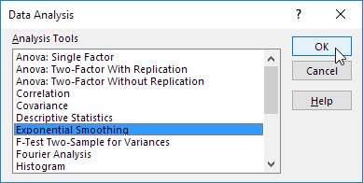
Exponential Smoothing
2. On the Data tab, in the Analysis group, click Data Analysis.
3. Select Exponential Smoothing and click OK.

Slide 7
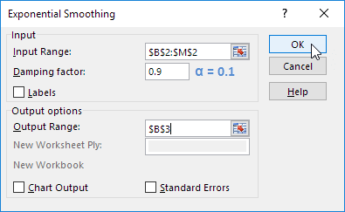
Exponential Smoothing
4. Click in the Input Range box and select the range B2:M2.
5. Click in the Damping factor box and type 0.9. Literature often talks about the smoothing constant α (alpha). The value (1- α) is called the damping factor.
6. Click in the Output Range box and select cell B3.
7. Click OK.

Slide 8
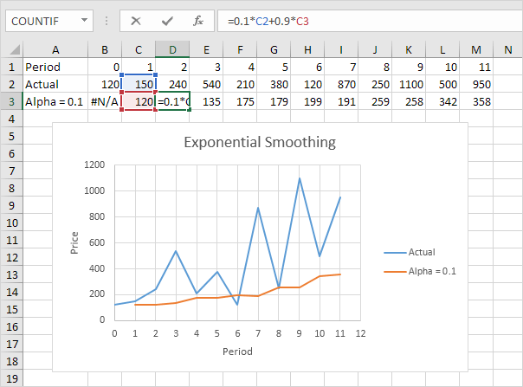
Exponential Smoothing
8. Plot a graph of these values.
Explanation: because we set alpha to 0.1, the previous data point is given a relatively small weight while the previous smoothed value is given a large weight (i.e. 0.9). As a result, peaks and valleys are smoothed out. The graph shows an increasing trend. Excel cannot calculate the smoothed value for the first data point because there is no previous data point. The smoothed value for the second data point equals the previous data point.

Slide 9
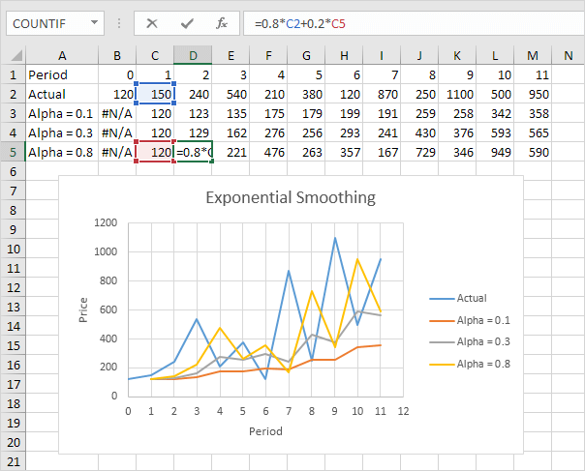
Exponential Smoothing
9. Repeat steps 2 to 8 for alpha = 0.3 and alpha = 0.8.
Conclusion: The smaller alpha (larger the damping factor), the more the peaks and valleys are smoothed out. The larger alpha (smaller the damping factor), the closer the smoothed values are to the actual data points.

Slide 10
References
Books:
1. Microsoft Excel 2013 Step by Step by Curtis D. Frye; Microsoft Press 2013.
2. Learning Tableau by Joshua N. Milligan,ISBN 139781784391164, PACKT Books - Packt Publishing
Reference Books:
Excel: Quick Start Guide from Beginner to Expert, by William Fischer
Web:
1. https://www.excel-easy.com/examples/correlation.html

Slide 11
For Queries Contact
Dr.L.Godlin Atlas
Email Id: godlin.atlas@galgotiasuniversity.edu.in
Whatsapp: 9080806220

Slide 12


